Slide 1
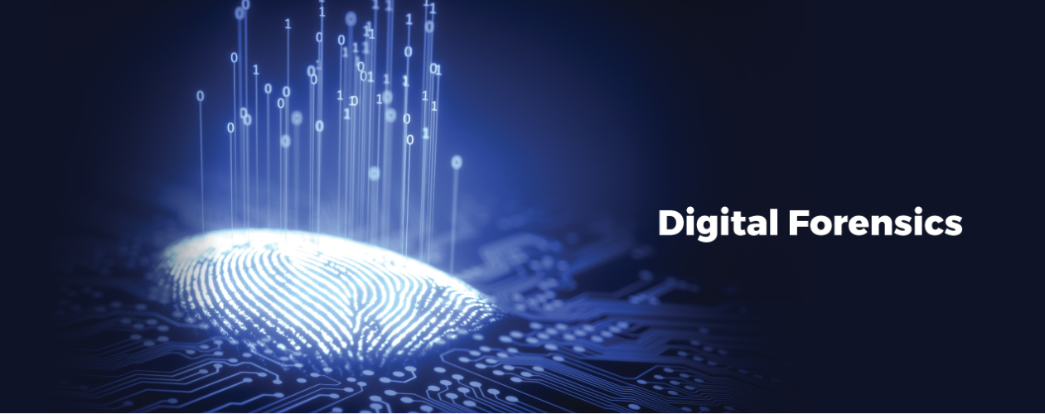

Slide 2
What Is Digital Forensics?
Digital forensic science is a branch of forensic science that focuses on the recovery and investigation of material found in digital devices related to cybercrime.
The term digital forensics was first used as a synonym for computer forensics. Since then, it has expanded to cover the investigation of any devices that can store digital data.
The first computer crime was reported in 1978, followed by the Florida computers act, it wasn’t until the 1990s that it became a recognized term. It was only in the early 21st century that national policies on digital forensics emerged.
Digital forensics is the process of identifying, preserving, analyzing, and documenting digital evidence. This is done in order to present evidence in a court of law when required.

Slide 3
What Is Digital Forensics?
“Digital forensics is the process of uncovering and interpreting electronic data. The goal of the process is to preserve any evidence in its most original form while performing a structured investigation by collecting, identifying, and validating the digital information to reconstruct past events.
The context is most often for the usage of data in a court of law, though digital forensics can be used in other instances.”
-Techopedia

Slide 4
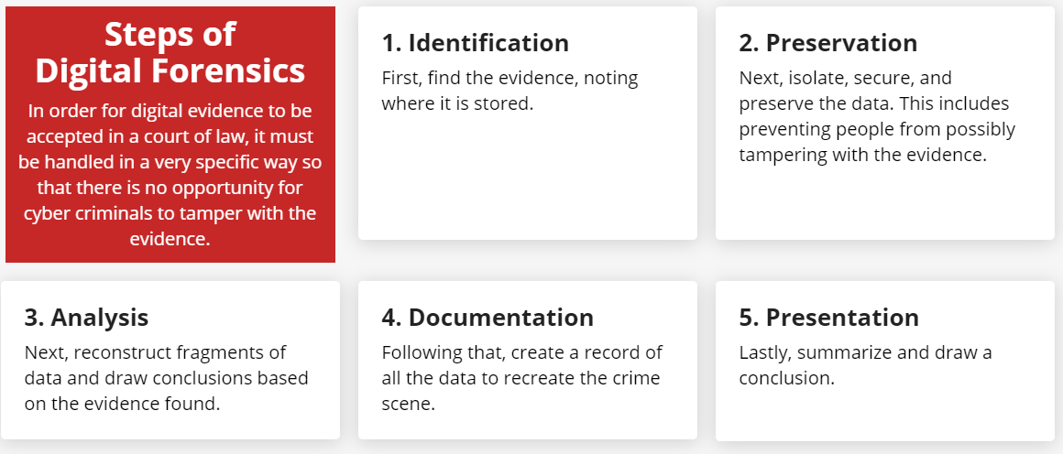
Steps of Digital Forensics

Slide 5

When Is Digital Forensics Used in a Business Setting?
For businesses, Digital Forensics is an important part of the Incident Response process.
Forensic Investigators identify and record details of a criminal incident as evidence to be used for law enforcement.
Rules and regulations surrounding this process are often instrumental in proving innocence or guilt in a court of law.

Slide 6
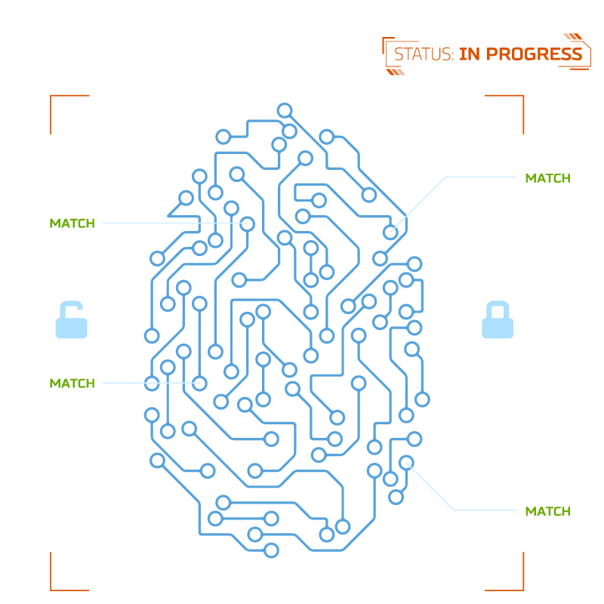
Who Is a Digital Forensics Investigator?
A Digital Forensics Investigator is someone who has a desire to follow the evidence and solve a crime virtually.
Imagine a security breach happens at a company, resulting in stolen data.
Under those circumstances, a digital forensic investigator’s role is to recover data like documents, photos, and emails from computer hard drives and other data storage devices, such as zip and flash drives, with deleted, damaged, or otherwise manipulated.

Slide 7
How Is Digital Forensics Used in an Investigation?
Digital footprint is the information about a person on the system, such as the webpages they have visited, when they were active, and what device they were using. By following the digital footprints, the investigator will retrieve the data critical to solving the crime case. To name a few –Matt Baker, in 2010, Krenar Lusha, in 2009, and more cases were solved with the help of digital forensics.
Cyber forensic investigators are experts in investigating encrypted data using various types of software and tools. There are many upcoming techniques that investigators use depending on the type of cybercrime they are dealing with.
Cyber investigators’ tasks include recovering deleted files, cracking passwords, and finding the source of the security breach. Once collected, the evidence is then stored and translated to make it presentable before the court of law or for police to examine further.

